Slide 1
Ann Arbor Trails Middle School Team
Adrian Boykin
LaTonia Clark
LaShawn Earley
Lamita Kinchloe
Romero Pratt

Slide 2
ELA & Reading
Ms. Kinchloe
Office Hours: 8:40 - 9:15 a.m.
lamita.kinchloe@detroitk12.org
f
6th Grade Novel
2-hour block class:
7:42-8:42 a.m.
9:26-1016 a.m.
School Supplies
Pencils, Pens, Color Markers, Crayons, Coloring Pencils, Blank Copy Paper, Construction Paper, Glue/Tape, etc.
7th Grade Novel
2-hour block class:
10:18-11:08 a.m.
11:57-12:47 p.m.
APPs & Platforms
Clever.com
TEAMS
Schoology
I-Ready
MyON
Class Dojo
8th Grade Novel
2-hour block class:
12:49-1:39 p.m.
1:40-2:30 p.m.

Slide 3
6th thru 8th Grade Mathematics
Mrs. Clark
latonia.clark@detroitk12.org
Offices hours 7:40 a.m - 8:30 a.m. (also available from 3 to 4 M thru F)
https://dpscd.schoology.com/course/2906621083/materials
DPSCD Parent Academy - Parent Online Training
https://dpscd.schoology.com/template/2950104690
https://dpscd.schoology.com/template/2950104692

Slide 4
Social Studies
World Geo. 6th
Contact Info:
Mr. R. Pratt
romero.pratt02@detroitk12.org
Office Hours: 1:40pm - 2:40pm
World His. 7th
U.S. His. 8th

Slide 5
Middle School Science 6-8
2020 -2021
La Shawn Earley
lashawn.earley@detroitk12.org
Office Hours:
Monday; 3:30 - 4:30 8th grade
Tuesday: 3:30 -4:30 7th grade
Thursday: 3:00-4:00 6th grade
IQWST engages students in scientific practices as they experience, investigate, model, and explain phenomena while learning core ideas and engaging in concepts that cross disciplinary boundaries. Students build understanding by connecting ideas from lesson to lesson, from module to module, and across the middle grades.
APPs & Platforms
TEAMS
Schoology
IQWST
CLEVER
Class Dojo
CURRICULUM
6th Grade - Physical Science: Can I Believe my Eyes
7th Grade - Intro to Chemistry: I can make New Stuff from Old Stuff
8th Grade - Life Science: What is Going on Inside Me.

Slide 6
AAT Resource Program
Mrs. Boykin
adrian.boykin@detroitk12.org
Office hours: 8:35-9:30 a.m.
Provide virtual small group instruction.
Correspond with core teachers regarding class assignments.
Provide updates on students progress.
Ensure that modifications and accommodations are being implemented per the IEP.

Slide 7
Microsoft Teams
Rules and Etiquette

Slide 8
Limit your distractions
You can limit your distractions by choosing a quiet place in your house to work.
Make sure none of your family members are present in the session.

Slide 9
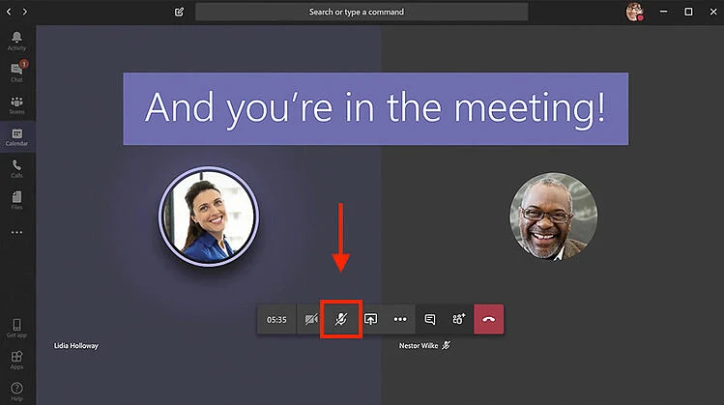
Keep microphones muted
Just like in the classroom, it is rude to talk at the same time as the teacher.
Keep your microphone on mute unless I ask you to turn it on to ask or answer a question.
If you are given permission to speak, turn on your microphone to speak but remember to turn it off again once you have finished.

Slide 10
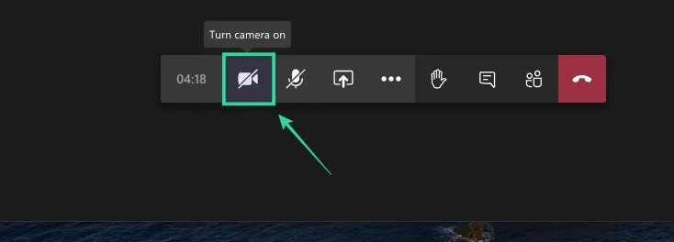
Turn your camera on
Although you are joining class online, you should present yourself just as you would in a face-to-face classroom.
Think about what you are wearing- is it appropriate? You will also want to find a comfortable workspace. Try finding a blank wall in your house to be the background for this call.

Slide 11
Chat
You can use the chat feature to make relevant comments or ask questions.
If you do have a comment/question, please ask it properly and not with abbreviations or slang.
Emojis are okay, just don’t overdo it.
Throughout our call, I will try to answer any questions you might have.

Slide 12
End of the Chat
When it is the end of the call, you need to leave the chat. I will not leave the chat unless all students do.

Slide 13
Respect
And most importantly, remember we are all respectful students. Please speak and chat in a respectful manner.

Slide 14
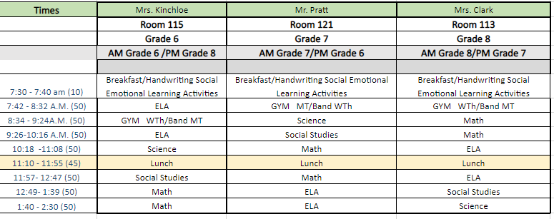
Respect
And most importantly, remember we are all respectful students. Please speak and chat in a respectful manner.

